Slide 1

Welcome to Software Development

Slide 2
About me
Fiona Knight - f.l.knight@staffs.ac.uk
Course Leader - Undergraduate Software Development
Lecturer on
Software and web modules
Interaction Design and UX

Slide 3
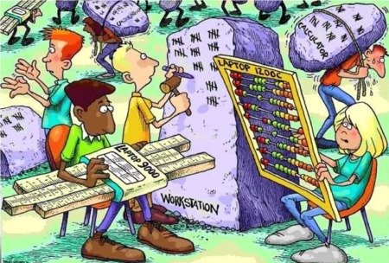
Where would we be..
..Without computers?
Computers need software

Slide 4
What runs the world…
How many of you have used a mobile phone today?
How many of you game on your computer (or tablet or phone)
How many of you use social media or YouTube
How many of you watch Netflix / Amazon / Disney+

Slide 5

Why is that relevant?
All these need software
Add to that cars, home systems, signage on the roads, electronic billboards

Slide 6
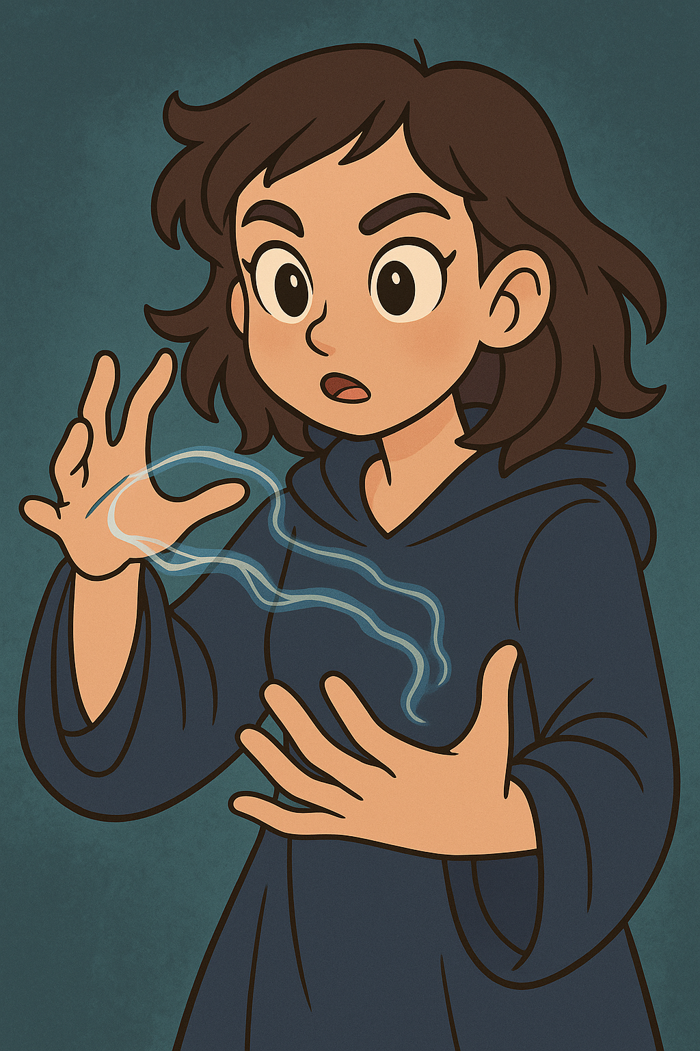
Software is…
..invisible magic
Without it.. imagine what life would be like?
You can learn it and use the power to do all sorts of things

Slide 7

Languages
3 languages to learn how to program

Slide 8
Examples
Fortnite – C++
TikTok filters – Python / AI
Self driving cars – AI + Python
Music Apps – JavaScript
Netflix recommendations – Machine Learning

Slide 9
Does it lead to a good career?
Lots of jobs around
Lots more remote / hybrid work too
https://uk.indeed.com/jobs?q=junior+software+developer&l=uk

Slide 10
So let us code
Using JavaScript/HTML/CSS as all you need is a web browser and something like notepad or VS Code to code in
Going to code a simple game
Has a 10 second countdown timer
Moves a picture of a tambourine around the screen
When you click on it
Makes a sound
Adds 1 point
To win you need 5 points before the timer runs out
Displays a message when you have 5 points or the end of the game

Slide 11
Stage 1 – Create the inputs and outputs
HTML page (index.html) with space for
Score
Time left
Picture to click
End game message
Snippet 1

Slide 12
Stage 2 – Add some style
CSS page (style.css)for
Positioning the image
Setting the font
Snippet 2a
Link in HTML page under title
Snippet 2b

Slide 13
Stage 3 – Hook up the JS
Add some test code to a file code.js
Snippet 3a
Link in HTML page under style
Snippet 3b
Save all and test in browser to see the alert

Slide 14
Stage 4 – Add comments to show what you will do
Add comments to help you code
Snippet 4

Slide 15
Stage 5 – Code links and initialise
//link to html items – snippet 5a (constants)
// initialise
// set up score, max score, time left, game over state – snippet 5b (variables)
// set up timers – snippet 5c (running code every 1000ms)
// set up sound – snippet 5d (audio file)
// set up listener for click on instrument – snippet 5e (listener for event of click)
// make first move – snippet 5f (running a function)

Slide 16
Stage 6 – Code base functions
Set up functions, each with an alert
//functions (code bits) – snippet 6
// move instrument
// update timer
// click instrument
// end game
Test it in the browser with the console open

Slide 17
Stage 7 – Add code (replacing existing functions)
Add code to each function
//functions (code bits) – snippet 7
// move instrument
// update timer
// click instrument
// end game
Test it in the browser (close console if it works)

Slide 18
Stage 8 – Extend it
Make it move faster
Change the image
Random sound
Random image
Code it yourself - https://github.com/fi67/tamb

Slide 19
What degree can you do
Software Development
Computer Science
Related
Cyber Security
Artificial Intelligence
Cloud and Networks

Slide 20

Thank You ☺
Any questions?
F.L.Knight@staffs.ac.uk

